Slide 1
Predicting Heart Disease
Using ML and the UCI Heart Disease Dataset

Slide 2
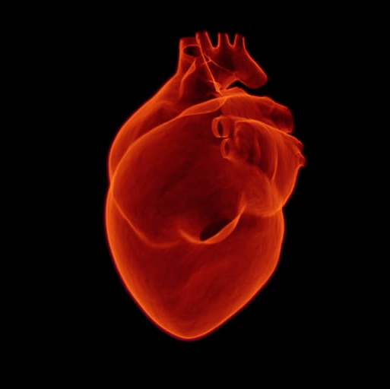
Impact
Leading cause of death in the US
1 in every 5 deaths (US) is a direct result of the condition
Someone dies of it every 30-45 seconds
Costs the country between 2 and 3 billion dollars every year (i.e., healthcare services, medicines, lost productivity due to death, etc.)

Slide 3

Identification
Identification and prevention of HD is one of the most important topics in the healthcare industry
Primary prevention models are not accurate enough to be effective.
Low estimates put their accuracy at just under 60%
High estimates place them around 80%
ML models are being used to increase the accuracy of heart disease identification and improve treatment outcomes

Slide 4

Project Goal
Come up with a supervised learning model that could outperform the current gold standard in primary prevention models
Use the UCI Heart Disease Dataset
Predict heart disease with greater than 80% accuracy

Slide 5
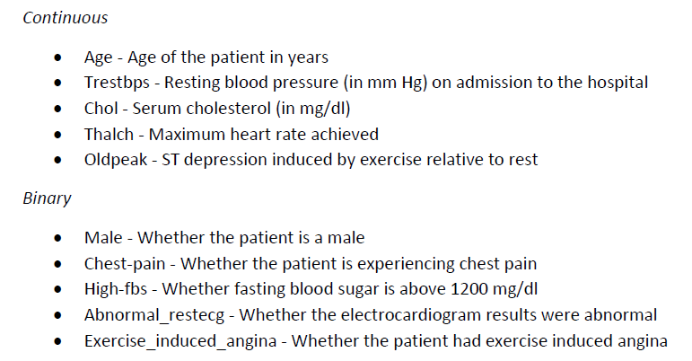
Dataset
UCI Heart Disease Dataset
Sixteen columns of data and 920 observations
Four sub-datasets merged to form this dataset, and each sub-dataset corresponds to a different hospital
Cleveland
Hungary
Switzerland
VA Long Beach
Data excluded from modeling process
Three predictive features that were missing a third or more of their values
About 6% of the patients that were missing 40% or more of their data
Final dataset had 865 patients and 10 predictive features (five continuous and five binary features)

Slide 6
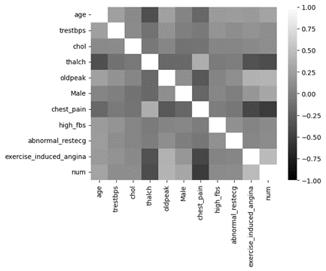
Exploratory Data Analysis
Project focused on classifying patients as (1) “has heart disease” and (0) “does not have heart disease”
Bonferroni corrected t-tests of (continuous features) showed significant differences between groups at the .05 level for all five features
Bonferroni corrected chi-squared tests (binary features) showed significant differences at the .05 level for all but one of the features (high_fbs)
Thalch and chest pain were the only two features not positively correlated with “has heart disease”

Slide 7
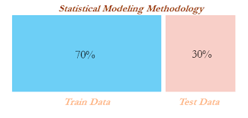
Model Training - Preprocessing
Data was first split into training (70%) and testing (30%) sets
Missing values were imputed with either the mean or the median.
If necessary, features were then scaled

Slide 8
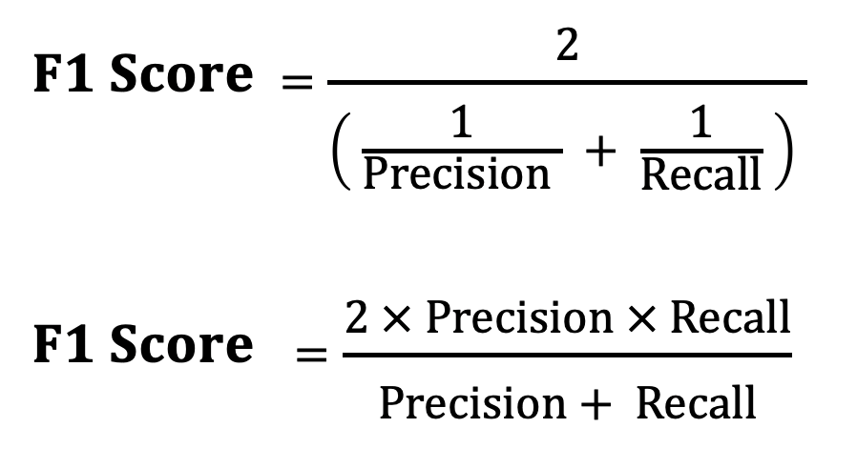
Model Training - Initial Evaluation
Five different models were evaluated during training:
Logistic Regression
AdaBoost with a Decision Tree estimator
AdaBoost with an SVM Estimator
AdaBoost with a Logistic Regression Estimator
Random Forest
Hyperparameters were selected using either GridSearchCV or RandomizedSearchCV (n_iter = 180)
One of each model was selected for the final model selection process
Hyperparameters for the best models were determined by the highest cross-validation F1 score during training

Slide 9
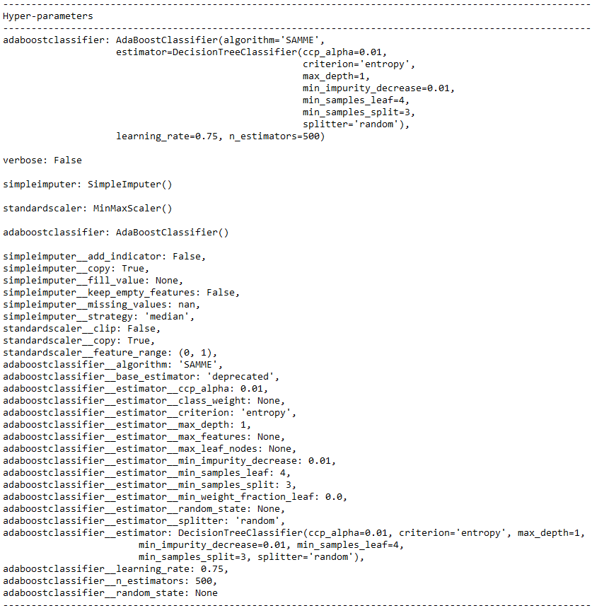
Model Training - Final Selection
Model with the highest F1 score on the testing set was chosen as the best model
Adaboost model with Decision Tree estimator (F1 score = 0.84), narrowly outperformed the other Adaboost models
Final model did not use any scaling and missing values were imputed using the median

Slide 10
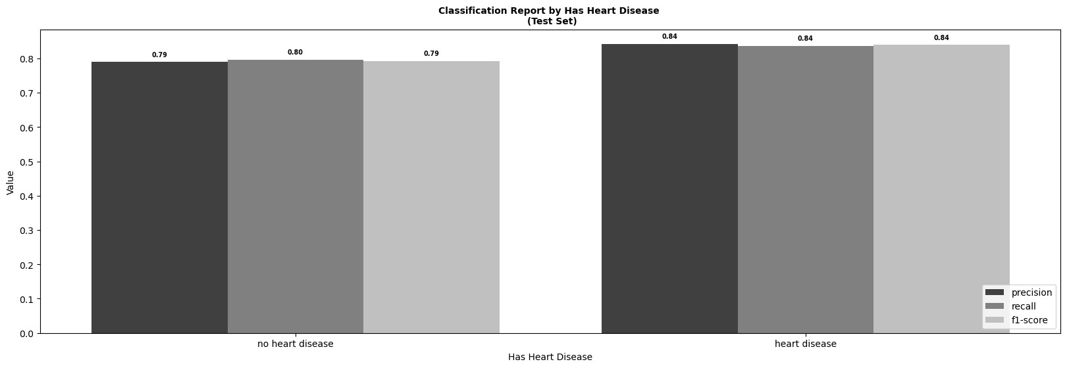
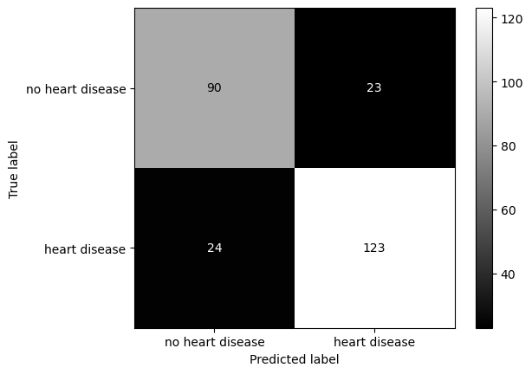
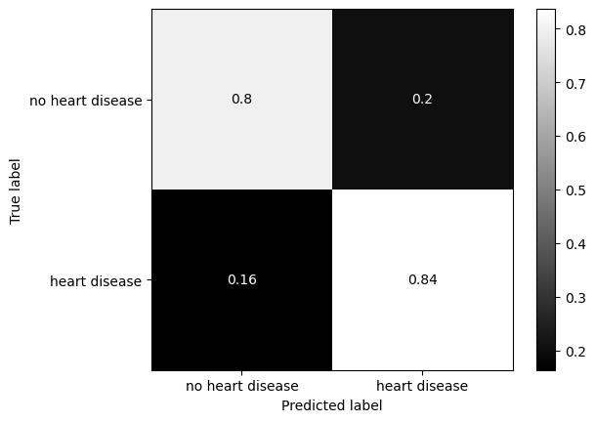
Testing Set - Further Analysis
Model was better at classifying heart disease patients than those without the condition
Better to make this type of error (Type I) since patients are better off taking precautionary measures with their lifestyle if they are a fringe case

Slide 11
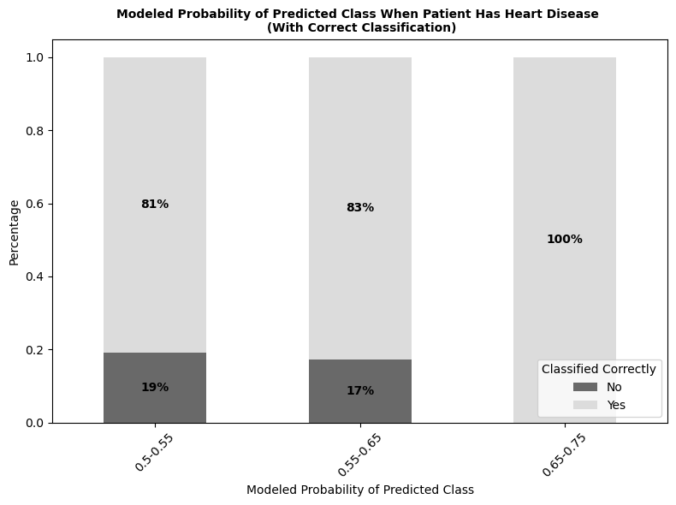
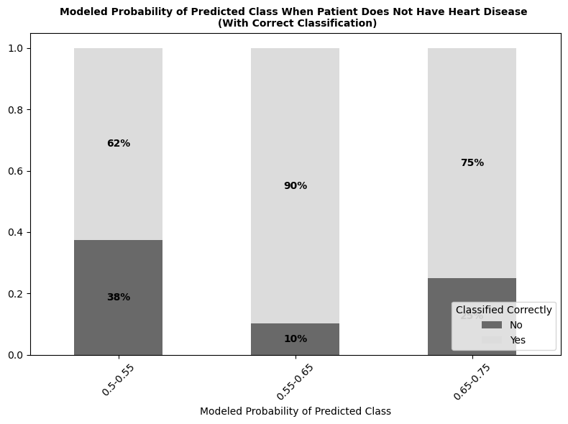
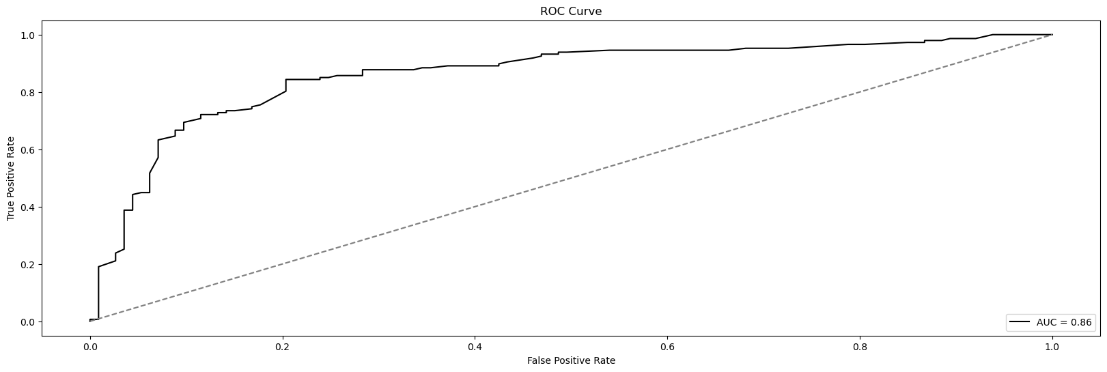
Testing Set - Further Analysis (continued)
Model tended to perform better when it was more confident in a prediction
Effect was more pronounced for cases when the patient had heart disease
Plotting the true positive rate against the false positive rate showed that it was doing a really good job overall (despite differences between classes)

Slide 12
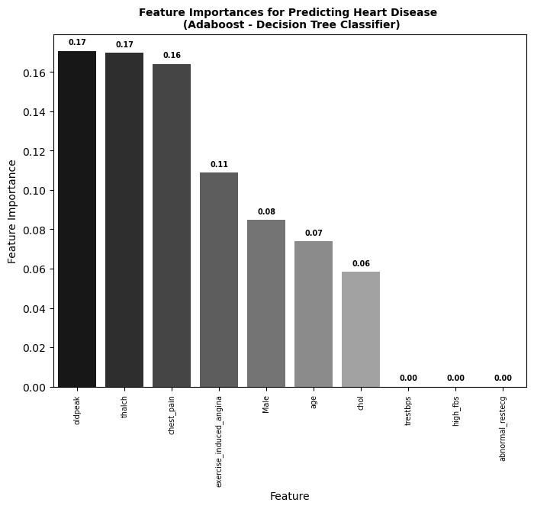
Feature Importances
Decision Tree estimator gave insight into which features were most important (ordered below):
ST depression induced by exercise relative to rest (oldpeak)
Maximum heart rate achieved (thalch)
Whether or not a patient had chest pain
Exercise induced angina, sex, age, and cholesterol were also important features

Slide 13

Final Thoughts and Future Research
Model met initial goal of predicting heart disease with > 80% accuracy
Was better at identifying cases when patients had heart disease than when they did not
Ideas for future research:
Add other features related to exercise (2 of the top 4 features were exercise-related)
Incorporate three predictive features that were dropped at the beginning of the project
Add data from other hospitals
Explore whether the predicted probabilities could be used to come up with a risk score

Slide 14
Thank you.

